Slide 1
Business Intelligence

Slide 2
Improvement in Decision Making Process
We make decisions every day at work.
Some are small (“What will I have for lunch today?”) and some are big (“Should I ask for a raise?”).
And, naturally, some people are better than others at making smart choices and achieving desirable outcomes.
But with a little effort, you can improve your decision-making skills.

Slide 3
Strong Decision-Making Skills
Active listening
Adaptability
Clear communication
Creativity
Critical thinking
Leadership
Logic and reasoning
Problem solving
Teamwork
Time management
Willingness to learn

Slide 4
Take Your Time
Patience more likely falls under character traits than it does decision-making skills, but it's a huge help.
Most problems don't require you to make a split-second decision.
Sure, the occasional emergency pops up, but most work issues allow you time to gather information so that you can weigh your options effectively and make smart choices.

Slide 5
Also, by avoiding making impulsive or emotionally-charged decisions, you'll be better equipped to use rational thinking when assessing a situation, which will help prevent you from making costly mistakes.
So, if you're feeling pressure from a co-worker to make a decision, don't be afraid to say, “I need some time to take a step back and gather information before I give you an answer.”

Slide 6
Start with the Desired Outcome
Before you evaluate your options, figure out what a successful outcome looks like.
Looking to address a data breach?
Think about what level of security measures you're looking to install.
Need to resolve a conflict with a co-worker? Picture what kind of relationship you're looking to build.
Having that kind of goal clarity upfront will help you reach the result that you want to achieve.

Slide 7
Weigh the Pros and Cons
Running a cost-benefit analysis of each possible decision will enable you to make smart choices.
One way to effectively envision the consequences of your actions is to put pen to paper and make a list of each action's pros and cons that you can then use to narrow your options.

Slide 8
Use Past Experience as a Guideline
Think about whether you've faced a similar dilemma in the past (there's a good chance you have), and analyze whether the decision you made achieved successful results.
Learning from mistakes helps you make better choices in the future.

Slide 9
Measure the Results
Remember how we said data is your friend? Once you've made a decision and acted on it, you must evaluate the outcome.
Survey client satisfaction rates.
Did lowering the price of a product increase sales?
Which efforts of your fundraising campaign raised the most money? Use the results to inform future decisions.

Slide 10
Learn from Your Mistakes
Embracing failure is integral to growing as a professional while also improving your decision-making skills.
One blunder doesn't make you a bad employee.
Developing a tough skin, especially if you're working in a cutthroat industry, is a must. Everyone makes mistakes—learning from them is what matters.

Slide 11
Get Help Making Good Choices for Your Career
It's not easy to know what to do in every given situation you face, but knowledge is indeed power.
Need help making important career choices, like determining how to ask for a raise, when to look for a new job, or how to hone your other professional skills?

Slide 12
Business Intelligence
Demand and technology are driving competition to its best if not to the edge, blurring the industrial boundaries and resulting in a substantial re-arrangement of businesses.
The advancement in information technology has also made it possible for organisations to hoard large volumes of data from multiple sources through their business processes

Slide 13
To remain competitive in the face of these changing times and fierce competition,
Tool is needed which has the capability to allow a holistic view of the operating environment of the organisation, by taking advantage of the huge body of accumulated data.
Thereby allowing decision makers to be spontaneous with their decision-making

Slide 14
Business Intelligence
Business intelligence, or BI, processes help you organize your data so it can be easily accessed and analyzed.
Decision-makers can then dig in and get the information they need quickly, empowering them to make informed decisions.
But improved decision-making is just one benefit of business intelligence.
Business Intelligence offers these capabilities and more, for instance the possibility to perform analytics operations about event(s) that demands more clarity on their behaviour

Slide 15
What is the need of business intelligence?
Business Intelligence enables businesses to have insight into what their competitors are doing and enables them to make informed and educated decisions for plans.
Also, a company that keeps an eye on its internal systems at all times, stays ahead of a company that doesn't.

Slide 16
Business Analytics Spectrum
Analyze, prepare reports and present to Leadership team on a defined frequency
or
Lead multiple analytical projects and business planning to assist Leadership team deliver business performance.

Slide 17
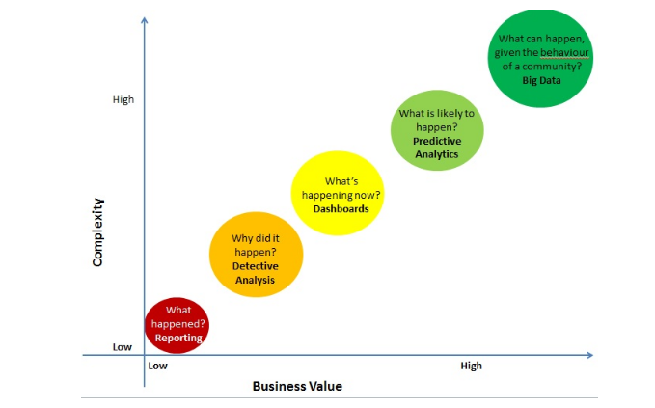

Slide 18
The domain of Analytics starts from answering a simple question – What happened?
This activity is typically known as reporting.
These are typically the MIS which people want to receive first thing in the morning.
It is a snapshot of what has happened.
Following is an example of how a typical report might look like:

Slide 19
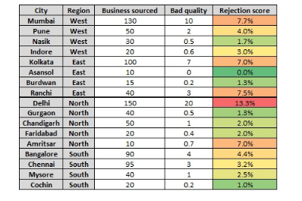

Slide 20
Tools used in reporting:
Majority of elementary reporting happens on MS Excel across the globe. More evolved Organizations might pull the data through databases using tools like SQL, MS Access or Oracle. But typically, the dissemination of reports happens through Excel.
Skills required for reporting:
MS excel
Business understanding
Ability to perform monotonous task with diligence

Slide 21
Detective Analysis
Detective Analysis starts where reporting ends.
You start looking for reasons for unexpected changes.
Typical problems you work on are “Why did the Sales drop in last 2 months?” or “Why did the latest campaign under-perform or over-perform?”.
In order to find out answers to these questions, you look at past trends or you look at distribution changes to find out the reasons for the changes.
However, all of this is backward looking.

Slide 22
Tools used in Detective Analysis
Typically used tools are MS excel, MS Access, Minitab, R (basic regression). You tend to use advanced Excel and Pivot tables while dealing with these problems and typically creating time series graphs helps a lot.
Skills required for detective analysis:
Structured thinking
MS Access, Excel, basic regression
Business understanding

Slide 23
Dashboard
Dashboard is an Organized and well presented summary of key business metrics.
They are usually interactive so that the user can find out the exact information he is looking for.
Dashboard, in ideal state should provide real time information about performance. Following is an example of how a dashboard might look like:

Slide 24
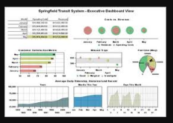

Slide 25
Skills required for creating dashboards:
Strong structured thinking: The person will need to create the entire architecture and data model
Business Understanding: If you don’t understand what you want to represent, God help you!

Slide 26
Predictive Modeling – Answer to What is likely to happen
This is where you take all your historical trends and information and apply it to predict the future.
You try and predict customer behavior based on past information.
Please note that there is a fine difference in forecasting and predictive modeling.
Forecasting is typically done at aggregate level, where as predictive modeling is typically done at a customer / instance level

Slide 27
Tools used for Predictive modeling:
SAS has the highest market share among tools used for predictive modeling followed by SPSS, R, MATLAB.
Skills required for Predictive modeling:
Strong structured thinking
Business Understanding
Problem Solving

Slide 28
Big data – Answer to What can happen, given the behaviour of the community?
Imagine applying predictive modeling with a microscope in hand.
What if you can store, analyze and make sense out of every information about the customer.
What kind of social media community he is attached to?
What kind of searches is he performing?
Big data problems arise when data has grown on all three Vs (Volume, Velocity and Variety).
You need data scientists to mine this data.

Slide 29
Tools used in Big data:
This is a very dynamic domain right now.
A tool which used to be market leader 6 months back is no longer the best.
Hence, it is difficult to pin down specific tools.
These tools typically work on Hadoop to store the data.

Slide 30
Skills required for harnessing big data:
Strong structured thinking
Advanced Data Architecture knowledge
Ability to work with unstructured data
So, now that you understand the Analytics spectrum, if you come across a role which is not clear to you, please spend the necessary time understanding which domain does it refer to and does it fit right with what you want to achieve.

Slide 31
Value Drivers and information use
A value driver is an activity or capability that adds worth to a product, service or brand.
More specifically, a value driver refers to those activities or capabilities that add profitability, reduce risk, and promote growth in accordance with strategic goals.
Such goals can include increasing shareholder value, competitive edge and customer appeal.

Slide 32
Value drivers are the factors that are likely to have the greatest impact on a company's success, and they are specific to different industries and companies.
For example, the value drivers motivating a healthcare company to move certain business processes from on-premises to cloud-based systems would be different than those motivating a manufacturing company seeking to implement digital manufacturing technology and link different data silos and processes of the manufacturing lifecycle.

Slide 33
Determining a true value driver requires thinking of long-term gains, and not getting swayed by trendy processes or technologies that don't add tangible value or are only a short-term win.

Slide 34
Performance metrics and key Performance indicators (KPI)
Metrics and KPIs are often confused, but the clear difference is KPIs are the key measures that will have the most impact in moving your organization forward.
They clearly articulate and provide insight into what your organization needs to measure and achieve to reach your long-term objectives.
Great strategic plans have 5-7 clear Key Performance Indicators that keep the pulse on how you’re performing against your plan.

Slide 35
Metrics also track and provide data on your organization’s standard business processes but are not the most important metrics your organization needs to measure, monitor, and perform against to make progress against your strategic plan.
It’s easy to use the two terms interchangeably, but here is a good way to think about it.
Key Performance Indicators help define your strategy and clear focus.
Metrics are your “business as usual” measures that still add value to your organization but aren’t the critical measure you need to achieve.
Every KPI is a metric, but not every metric is a KPI.

Slide 36
KPIs are comprised of four key attributes and your output should be 5-7 clear KPIs for your plan. Remember the following:
1) Define Your Measure – This sounds obvious, but every KPI must have a clear expression of what you need to measure. The more descriptive your performance measure, the better. You can categorize performance measures into these categories

Slide 37
Activity Measures –This measures activity and can include a percentage, number, currency and activities, or processes. An example of this measure would be the number of leads in your pipeline.
Outcome Measure – This measures progress against a defined outcome, often expressed as a percentage increase, change, or results from an outcome. An example of this would be % increase in revenue compared to last year.

Slide 38
Project Measure – This measures the progress of a project, often expressed as percent complete, a deliverable, activity, or process the owner can influence. An example would be % complete to complete XX strategic project.
Target Structure – These represent a numeric result against a date. A perfect example would be $XXXM in revenue by the end date of a strategic objective.

Slide 39
2) Define Your Target – Your target is the numeric value you’re setting out to achieve. Targets need to match your measurement type and due date.
If your measure is a percentage, your target needs to be a percentage. If your measure is a raw number, the target should be a raw number.

Slide 40
3) Outline the Data Source – Every KPI needs to have a clear data source.
Make sure you articulate where you are pulling your data from and what the calculations are so everyone is on the same page.

Slide 41
4) Define an Owner and Tracking Frequency – As with any SMART goal, a KPI needs to have a clear owner and defined tracking frequency.
So, make sure someone is accountable for pulling the data and updating performance on a defined frequency.
We recommend monthly in most cases.

Slide 42
KPIs measure performance based on key business goals while metrics measure performance or progress for specific business activities.
KPIs are strategic while metrics are often operational or tactical.

Slide 43
Performance metrics are data used to track processes within a business.
This is achieved using activities, employee behavior, and productivity as key metrics. These metrics are then used by employers to evaluate performance.
This is in relation to an established goal such as employee productivity or sales objectives.

